Slide 1
Research Ethics
Ethical Principles and Practice for the All Data Revolution
Stephanie Shipp
Social and Decision Analytics Division
DSPG 2022
June 21, 2022
Notes:
As part of your research, how many of you prepare and submit Institutional Review Board protocols?
I have completed dozens in my research over the last several years. And to be honest, I always thought of them as an administrative step to checkoff the list as a research project began.
But as I began to work more in the Big Data / All Data space, I began to realize that this is not just a necessary first step, but an activity that needs to be part of every research step.
The Institutional Review Board (IRB) is an administrative body established to protect the rights and welfare of human research subjects recruited to participate in research activities conducted under the auspices of the institution with which it is affiliated.
Abstract - The all data revolution has transformed the conduct of social science research, but the ethical dimensions should not be compromised. Researchers can now observe behavior based on repurposing existing data without consent or awareness by those providing the data. However, the principles set forth in the Belmont Report on Ethical Principles and Guidelines for the Protection of Human Subjects of Research are still as applicable as when these principles were first established in 1978. These principles emphasize responsibility to produce results that will benefit society. The principles are fairness (understand, mitigate, and communicate the presence of bias in both data practice and consumption); benefit (weighing risks and benefits of study); openness (practice humility and openness); transparent practices (community engagement, responsible communications); and reliability (ensure that every effort is made to understand the data and results). These Belmont principles should be exercised continuously and rigorously as researchers take on the challenge of repurposing data to answer new questions.
Discussions about ethics need to be a natural part of every research project, especially when repurposing data for analytical purposes. A publicly-shared ethical checklist at each research stage can help researchers identify and frame any potential concerns and evaluate their relative impacts. The checklist should cover all phases, from project selection and scoping to building a team, data discovery and acquisition, analysis, and implementation of results. A key part of this checklist is the assessment of implicit biases throughout the project, such as, what biases do the researchers have? Are biases introduced in the study through the choice of variable selection, like including males but not females or other genders? Are the right tools being used? Are methods and outputs transparent? The ethical principles involved here require the implementation of everyday practices around documentation, transparency, ongoing discussion, questioning, and constructive criticism.

Slide 2
Outline
Research Ethics and Practice
Definitions: Ethics, Implicit and Explicit Biases
Impact of Repurposing Data
Guiding Principles: Belmont & Menlo
Ethics Checklist
Notes:
During this part of the presentation, I want to discuss with you the practice of ethics in data science.
When we think about ethics in data science, there are two components:
1. How is ethics defines and what are the implicit and explicit biases that shape our ethical beliefs?
2. What are our responsibilities as data scientist when we repurpose existing data sources, especially those that are publicly available?

Slide 3
How Do You Define Ethics?
…moral principles that govern a person's behavior or the conducting of an activity.
If ethics is defined as shared values that help humanity differentiate right from wrong, the increasing digitalization of human activity shapes the very definitions of how we evaluate the world around us.
Ethics is a branch of philosophy that involves systematizing, defending, and recommending concepts of right and wrong behavior.
…a moral philosophy or code of morals practiced by a person or group of people
Notes:
How do you define ethics? Ethics has many dimensions from
the moral principles that govern a person’s behavior
To shared values that help people differentiate right from wrong
To morals practice of groups of people.

Slide 4
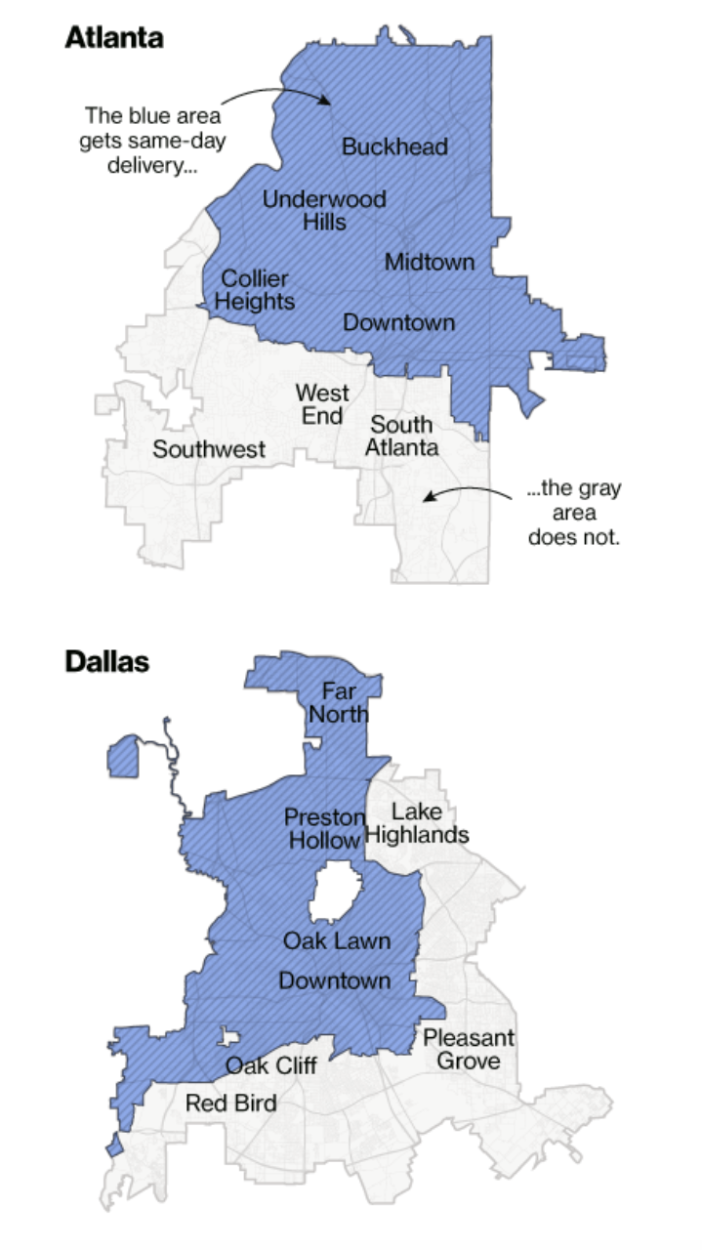
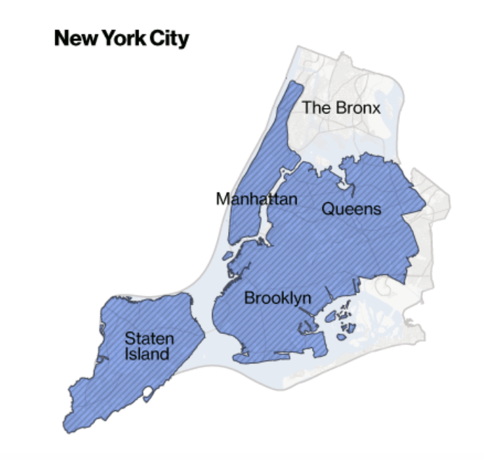
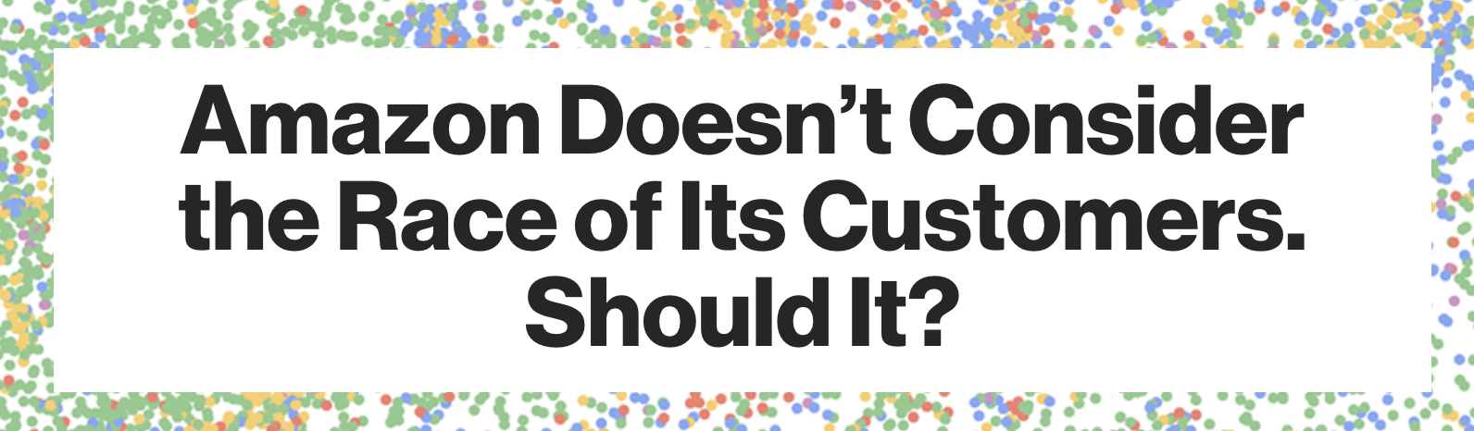

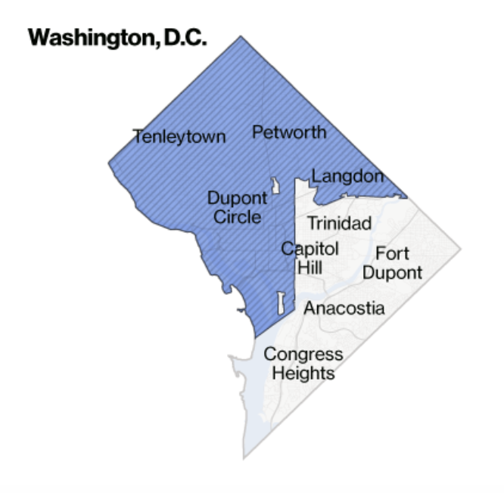
April 21, 2016
Source: https://www.bloomberg.com/graphics/2016-amazon-same-day/
Notes:
Let’s review two examples -
The first is an Amazon Prime example provides a good example implicit bias.
Amazon algorithmically determined which neighborhoods would get Prime Same Day delivery.
They did not consider race, yet the data mapped almost perfectly by race.
The blue areas are the ones that get same day delivery and white areas are primarily minority neighborhoods that were not planned for SAME DAY DELIVERTY.
So even though the algorithms did not use race, the data picked up the social biases, ….. and perhaps they should have used race.

Slide 5
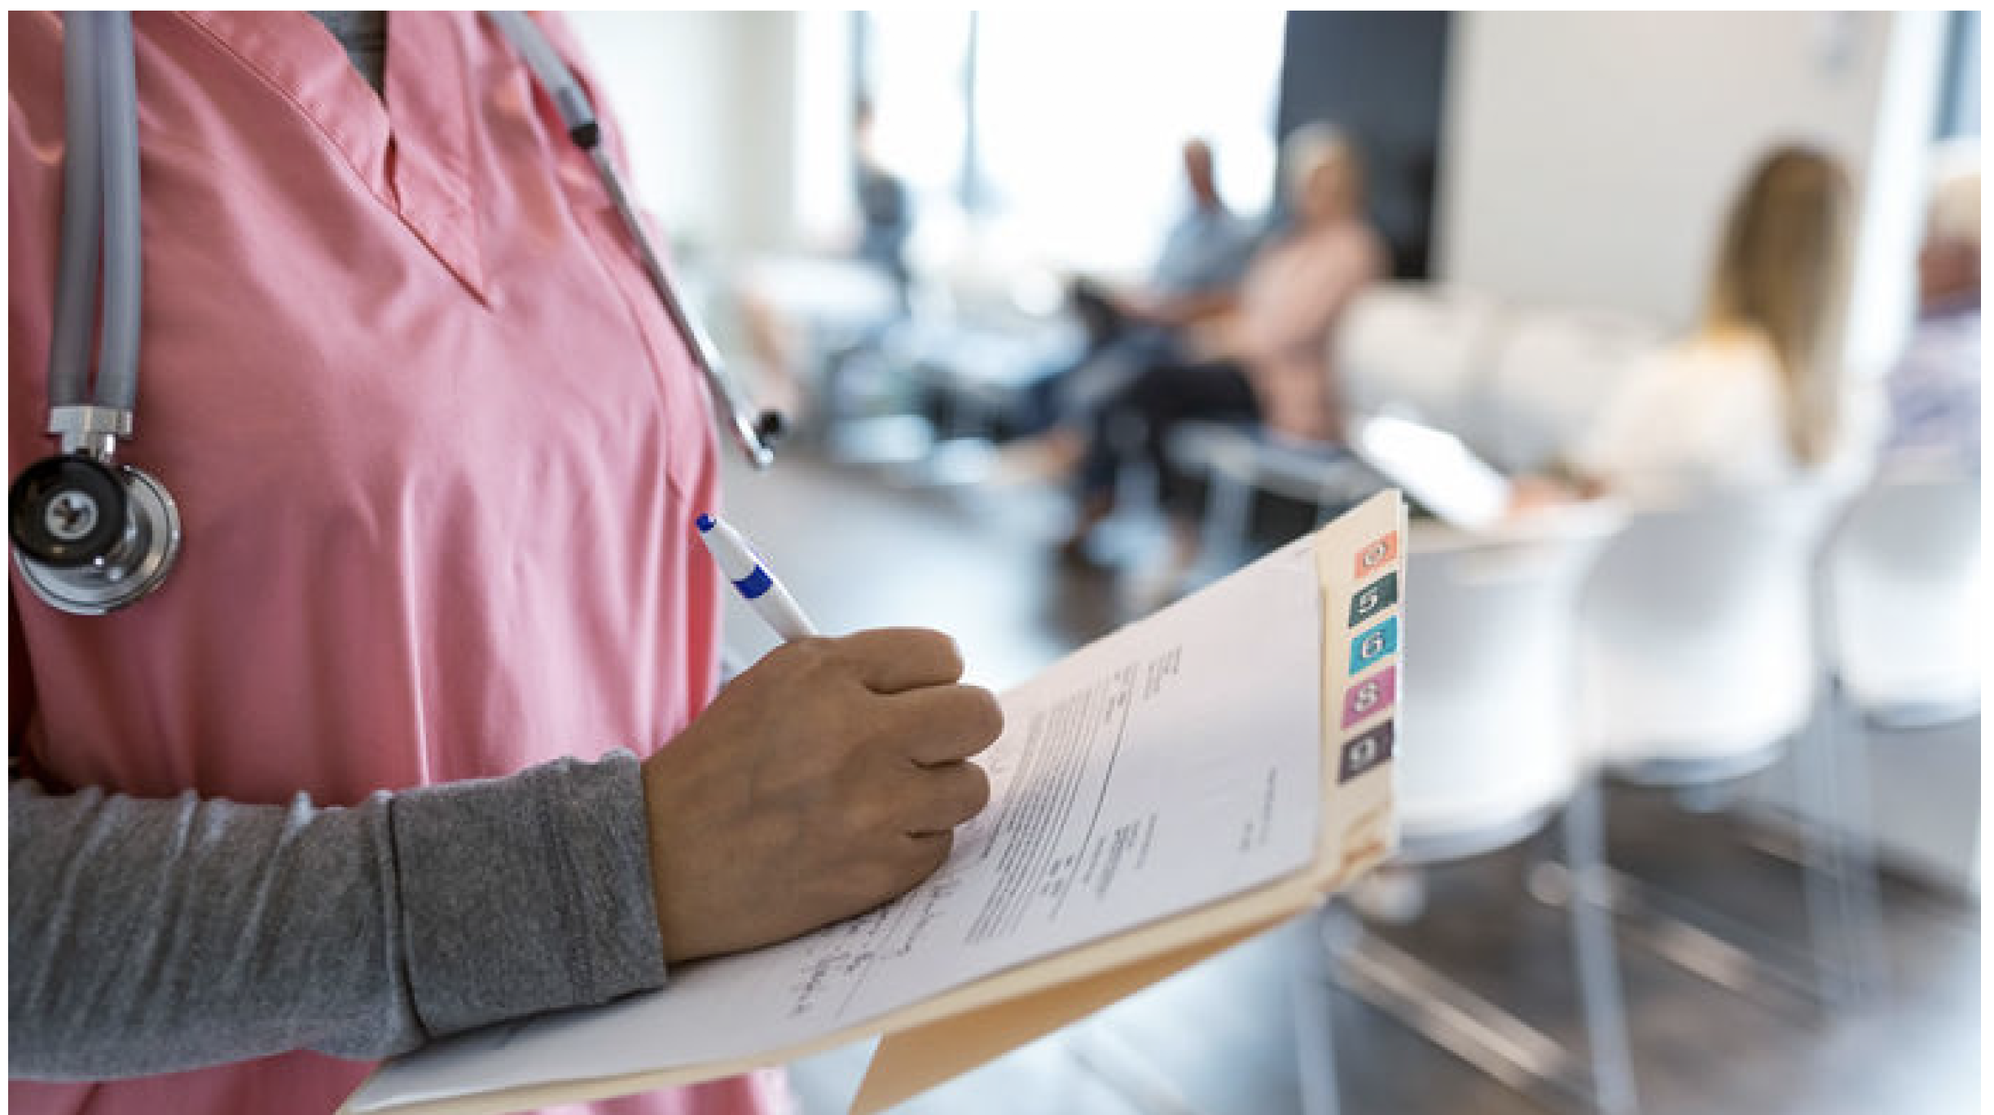
Hospital Risk Scores Prioritize White Patients
When health risk prediction algorithms focus on cost rather than illness, racial bias can creep in
Source: https://www.sciencemag.org/news/2019/10/hospital-risk-scores-prioritize-white-patients?utm_campaign=news_daily_2019-10-24&et_rid=475169293&et_cid=3044305
Notes:
Hospitals and insurance companies use algorithms to assign “risk scores” to more than 200 million Americans every year.
The scores are derived from bills and insurance payouts that track illnesses, hospitalizations, and other variables.
Independent health researchers examined how these risk scores are computed and validated. They found that black patients tend to have low-risk scores, even when they have deteriorating health conditions.
The problem is that using bills and insurance payouts as a proxy for a person’s overall health introduces bias because health care costs tend to be lower for black patients, regardless of their actual wellbeing. This is because they tend to go to doctors less often.
By tweaking the algorithm to predict the number of chronic illnesses that a patient will likely experience in a given year—rather than the cost of treating those illnesses—the researchers were able to reduce the racial disparity by 84%.
Both these examples point out the need to have internal and external reviews of the algorithms. And to the insurance company’s credit, they tested and adopted the new algorithms.

Slide 6
What is bias? Implicit bias? Explicit bias?
Implicit bias, also called unconscious bias or implicit social cognition, is a prejudice that is deep-seated within the brain, below the conscious level.
Explicit bias involves consciously held, self-reported attitudes that shape how people evaluate or behave toward members of a particular group.
Source: https://ethicsunwrapped.utexas.edu/wp-content/uploads/2018/11/Implicit-Bias-Teaching-Notes.pdf
Notes:
We just saw two examples of bias in the data and algorithms.
Psychologists at Harvard, the University of Virginia and the University of Washington created "Project Implicit" to develop Implicit Bias Tests to measure unconscious bias.
Early humans survived because they had the ability to quickly and automatically categorize people. Every day, we group other people into categories based on social and other characteristics. While this served to protect early human beings, it also forms the foundation of stereotypes, prejudice and, ultimately, discrimination.
Explicit bias is when you actively and consciously have attitudes that shape how you behave towards members of a particular group.
And as we saw in the two examples, these biases also exist in the data.
Statistical bias is a mathematical concept: Statistical bias is a feature of a statistical technique or of its results whereby the expected value of the results differs from the true underlying quantitative parameter being estimated
https://ethicsunwrapped.utexas.edu/wp-content/uploads/2018/11/Implicit-Bias-Teaching-Notes.pdf
https://www.tolerance.org/professional-development/test-yourself-for-hidden-bias
https://obamawhitehouse.archives.gov/sites/default/files/microsites/ostp/bias_9-14-15_final.pdf
https://plato.stanford.edu/entries/implicit-bias/

Slide 7
Stereotypes, Prejudice, Discrimination
A Stereotype | A Prejudice | Discrimination
…is an exaggerated belief, image or distorted truth about a person or group—a generalization that allows for little or no individual differences or social variation. Stereotypes can be positive or negative | …is an opinion, prejudgment or attitude about a group or its individual members. | …is behavior that treats people unequally because of their group memberships. Discriminatory behavior, ranging from slights to hate crimes, often begins with negative stereotypes and prejudices.
Source: https://www.tolerance.org/professional-development/test-yourself-for-hidden-bias
Notes:
A stereotype is an exaggerated belief, image or distorted truth about a person or group—a generalization that allows for little or no individual differences or social variation. Stereotypes are based on images in mass media, or reputations passed on by parents, peers and other members of society. Stereotypes can be positive or negative.
A prejudice is an opinion, prejudgment or attitude about a group or its individual members. A prejudice can be positive, but in our usage refers to a negative attitude. Prejudices are often accompanied by ignorance, fear or hatred. Prejudices are formed by a complex psychological process that begins with attachment to a close circle of acquaintances or an "in-group" such as a family. Prejudice is often aimed at "out-groups.”
Discrimination is behavior that treats people unequally because of their group memberships. Discriminatory behavior, ranging from slights to hate crimes, often begins with negative stereotypes and prejudices.

Slide 8
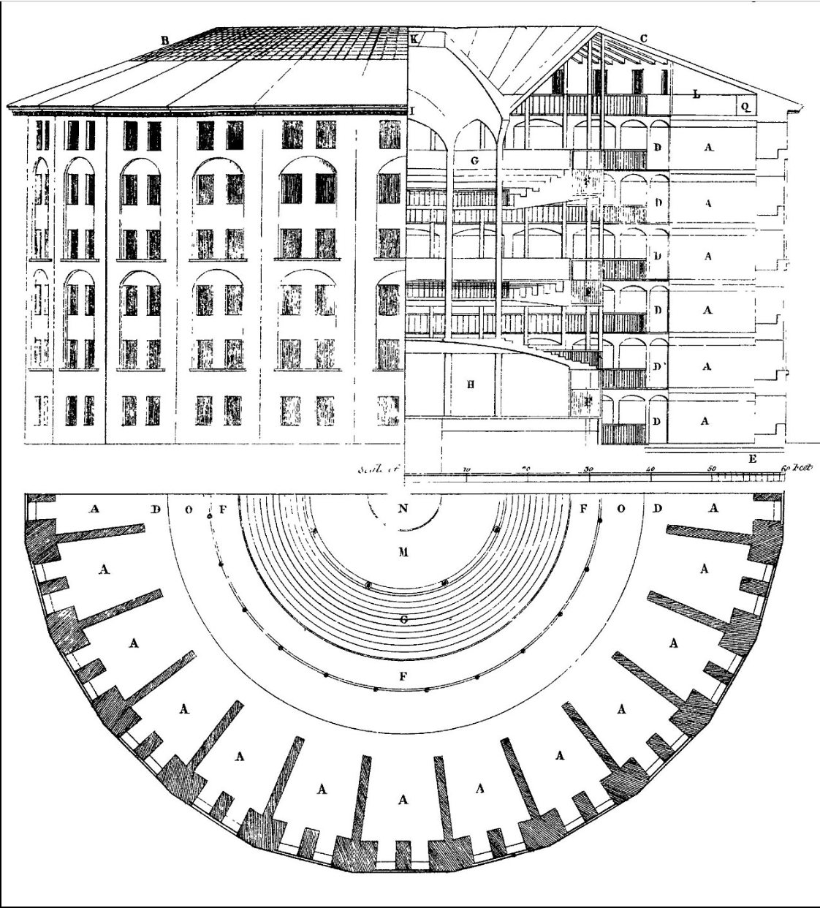
Data Science – Repurposing Data
Panopticon Prison Metaphor
Today, we can observe behavior based on repurposing existing data without consent or awareness by those providing the data
Requires a broader view of ethics that adapts to the spirit as well as the rules
Punish misuse; not restrict data access
Source: The Works of Jeremy Benthem, 1791, described in Salganik, Bit by Bit (2018)
Source: Keller, S. A., Shipp, S., & Schroeder, A. (2016). Does big data change the privacy landscape? a review of the issues. Annual Review of Statistics and Its Application, 3.
Notes:
One of the ethical challengers in today’s all data revolution is that we can observe behavior based on repurposing existing data without consent or awareness by those providing the data
The metaphor for this challenge is the Panopticon prison. This prison is a circular building with cells built around a central watchtower. Whoever occupies the the watchtower can observe the behavior of all people without being seen him or herself.
The prisoners are more likely to behave bc they are being watched; however, this is an imperfect metaphor, bc it is the researchers who are repurposing the data that should be watched to ensure good behavior without restricting access to these data.
Our view, is that instead of restricting access, we punish misuse of data.

Slide 9
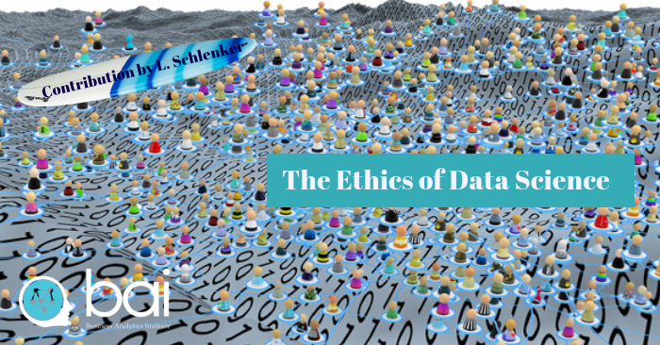
What About Ethics and Data Science?
If ethics is defined as shared values that help humanity differentiate right from wrong, the increasing digitalization of human activity shapes the very definitions of how we evaluate the world around us. - Lou Schenkler
…our ever-increasing reliance on information technology has fundamentally transformed traditional concepts of “privacy”, “fairness” and “representation”, not to mention “free choice”, “truth” and “trust”. - Margo Boenig-Liptsin
https://towardsdatascience.com/the-ethics-of-data-science-e3b1828affa2
Notes:
As data scientists, we have an obligation to keep ethics at the forefront of our thinking. We are using dat to improve the public good, not to identify individuals in the data and then use that data to gain an advantage,
In some countries legislation has been passed to ensure that researchers act as good data citizens,
The recent introduction of legislation in Europe (GDPR), India (the Personal Data Protection Act, 2018)., and California (the California Consumer Privacy Act of 2018) specifically recognize the rights of digital citizens and implicitly address the dangers of the commercial use of personal and personally identifiable data.
The ability to micro-target specific populations might be good if you are encouraging kids from low-income households to go to college, but might not be if these same kids are encouraged to sign up for expensive and perhaps not high-quality private trade or other education.
https://towardsdatascience.com/the-ethics-of-data-science-e3b1828affa2
https://blogs.scientificamerican.com/voices/silence-is-never-neutral-neither-is-science/

Slide 10
The Belmont Report
The Belmont Principles provide the foundation for the Institutional Review Board (IRB) process and for a principles-based approach to ethics.
Respect for persons – honoring individual wishes
Beneficence – weighing risks and benefits of study
Justice – fair distribution of risks and benefits
Led to the Common Rule which governs U.S. Government research
Focus is on “research involving human subjects”
1979
Notes:
Let’s step back and review the history related to research and ethics.
The Belmont Commission was convened in the late 1970s after ethical failures by researchers became known.
The most famous example of one of these failures is the Tuskegee Syphilis Study conducted from 1932-1972 to observe the natural progression of untreated syphilis of poor African-American men.
None of the men were told that they had the disease, and none were treated with penicillin even after the antibiotic was proven to successfully treat syphilis.
The Belmont Commission issued 3 principles for the conduct of ethical research
These principles are
Respect for persons – treating people as autonomous and honoring their wishes
Beneficence – understanding the risks and benefits of the study and weighing the balance between (1) do no harm and (2) maximize possible benefits and minimize possible harms.
Justice – deciding if the risks and benefits of research are distributed fairly
The principles were codified into law and are now referred to at the Common Rule.
The Belmont Report provided the foundation for the Institutional Review Board’s principles and focus on ‘research involving human subjects.” You took this training the first week you were here.

Slide 11
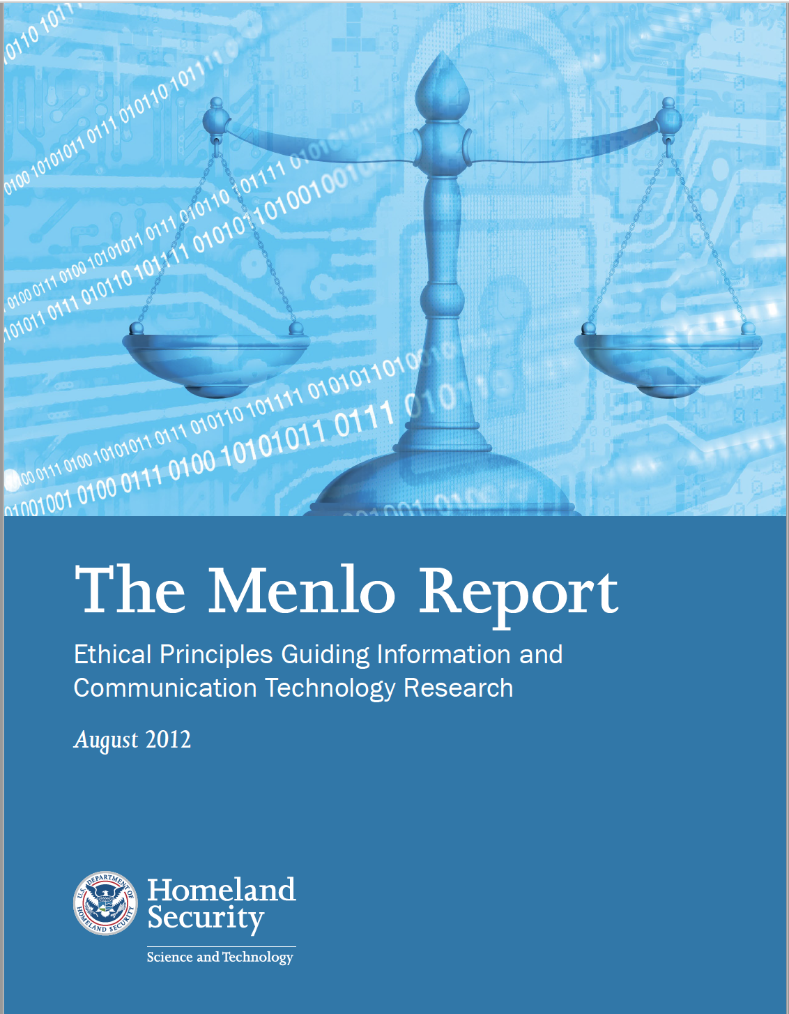
The Menlo Report
Department of Homeland Security commissioned a report to introduce Belmont principles in ICT (Information, Communication, Technology)
The Menlo Report extends the Belmont Principles to include Respect for Law and Public Interest
Focus is on “research with human-harming potential”
https://www.nature.com/articles/d41586-019-01720-7
Notes:
The Menlo report was commissioned by the Department of Homeland Security to bring the Belmont principles to the Information, Communication, and Technology or ICT community.
They also expanded the Belmont principles in two important ways:
They added a 4th principle - Respect for Law and Public Interest – extends principle of beneficence to include all relevant stakeholders
And they expanded the focus to include “research with human-harming potential,” not just a focus on “research on human subjects.”
This change is important in the digital age where the use of digital technologies and repurposing of data can expose people to risks.
We recommend that our projects should embrace the broader criteria set forth in the Menlo Report.

Slide 12
Refinement of Community Principles for Ethical Data Sharing
Fairness | Understand, mitigate and communicate the presence of bias in both data practice and consumption
Benefit | Put people before data and be responsible for maximizing social benefit and minimizing harm
Openness | Practice humility and openness, i.e., transparent practices
Reliability | Ensure that every effort is made to glean a complete understanding of what is contained within data, where it came from, and how it was created
https://www.nature.com/articles/d41586-019-01720-7
Notes:
These are principles that guide the responsible conduct of research.
The Community Principles on Ethical Data Sharing were formulated at a Bloomberg conference in 2017. The four principles are:
fairness to reduce bias;
maximizing societal benefits and minimizing harm;
maintaining open and transparent processes
ensuring complete understanding of the data including how it was born and its quality.

Slide 13
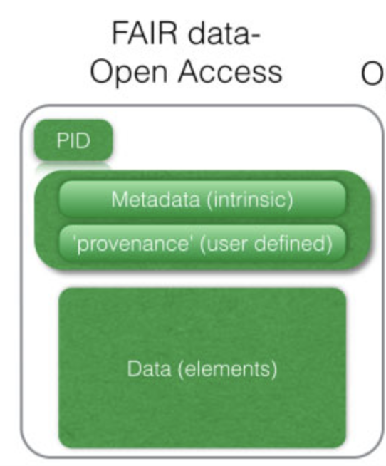
Refinement of Community Principles for Ethical Data Sharing
F.A.I.R
F | Findable using common search tools
A | Accessible so that the data and metadata can be explored
I | Interoperable to compare, integrate, and analyze; and
R | Reusable by other researchers or the public through the availability of metadata, code, and usage licenses (Stall et al., Nature 2019)
https://www.nature.com/articles/d41586-019-01720-7
Notes:
A systematic approach to implementing these principles is ensuring scientific data are FAIR:
‘Findable’ using common search tools;
‘Accessible’ so that the data and metadata can be explored;
‘Interoperable’ to compare, integrate, and analyze; and
‘Reusable’ by other researchers or the public through the availability of metadata, code, and usage licenses (Stall et al., 2019).
Underlying the FAIR principles is to also give credit for curating and sharing data and to count this as important as journal publication citations (Pierce et al. 2019).
The FAIR movement has taken hold in some scientific disciplines where issues surrounding confidentiality or privacy are not as prevalent.
Social sciences, on the other hand, face challenges in that data access are often restricted for these reasons.
However, the aim should be to develop FAIR principles across all disciplines and adapt as necessary. This requires creating repositories infrastructure and tools that make the FAIR practices the norm rather than the exception at both national and international levels (Stall et al., 2019).

Slide 14
Guiding Principles
Guides research
Guides responsible conduct of research
Belmont Principles
Respect for persons – honoring individual wishes
Beneficence – weighing risks and benefits of study
Justice – fair distribution of risks and benefits
Menlo Principles
Focus is on “research with human-harming potential”
Respect for Law and Public Interest
Data for Good Exchange
Fairness – understand and communicate presence of bias
Benefit - conduct community-driven research, not research in the community
Openness – be transparent in your research
Reliability - understand your data and how it was born
F.A.I.R.
Findable
Accessible
Interoperable
Reusable

Slide 15
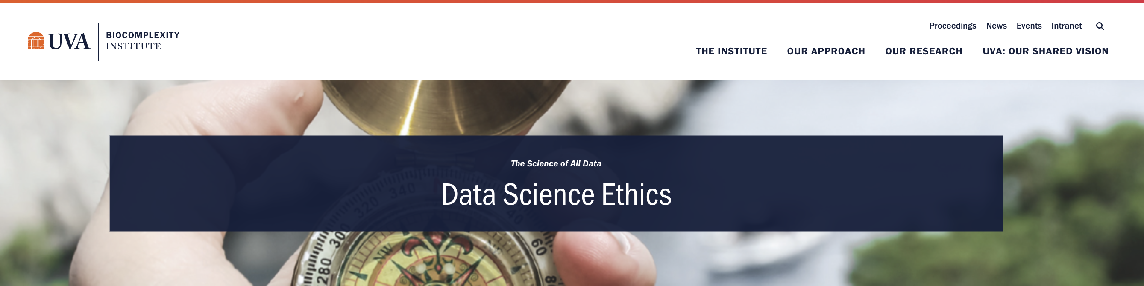
Using Data Science Ethics Tool
The first step for researchers to agree on a set of principles
Data science ethics tool template can be adapted to specific data science projects
Provides a set of guiding principles and questions to address the ethical decisions across the data lifecycle

Slide 16
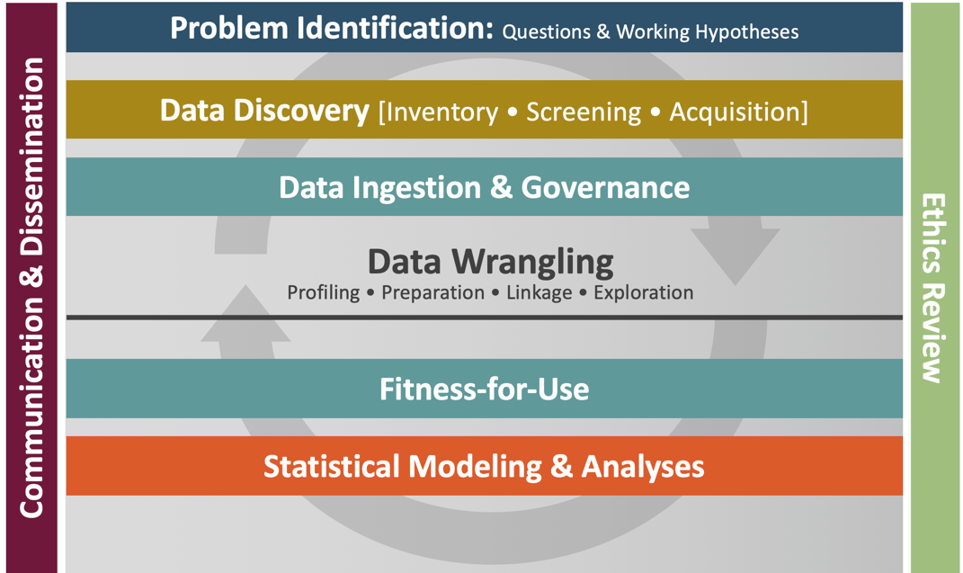
Ethics is an Integral Part of Our Data Science Framework
Source: Keller, S. A., Shipp, S., & Schroeder, A. (2016). Does big data change the privacy landscape? a review of the issues.
Annual Review of Statistics and Its Application, 3.
Notes:
Just having a checklist does not mean that this is easy. The checklist is a reminder that dialogue is needed at every stage of the research/.
Knowing the context is key. One of our teams last summer created vulnerability indexes for a nearby County.
They thought that populations that use well water and had septic systems were vulnerable. In the DC areas, it is generally high-income households w who live on 5 and 10-acre pieces of land and are quite wealthy that have well water and septic systems. In this case, the exploratory analysis provided the context. This area of the county also had the highest income.

Slide 17
Ethics Checklist for Data Science Research Projects
Project Initiation and Problem Identification
Data Discovery, Inventory, Screening, and Acquisition
Data Ingestion and Governance
4
Data Wrangling
Fitness-for-Use Assessment
Statistical Modeling and Analysis
After-Project Debriefing
1
5
2
6
3
7
Notes:
The DSF has 6 major steps and we added an after-project debriefing. Lets walk through each one.

Slide 18
Ethics Checklist: Project Initiation and Problem ID
Project Initiation. Problem Identification: Establish the ethical basis for undertaking the project as well as the project requirements for both the protection of research participants and the equitable allocation of all potential project benefits and risks.
Questions to consider before starting a project
What are the expected benefits of the project to the ‘public good’? Do they outweigh potential risks to certain populations?
Are there implicit assumptions and biases in the framing of the project regarding the studied communities and how will they be addressed?
Should the project be undertaken?
What type of institutional review board approval process is needed? Has the team reviewed the protocol?
Notes:
Initial discussions about project initiation should include whether the project will advance the public good and how.
Then clean, crisp research Qs need to be identified.
Read Qs from the slide
A key part of this checklist is the assessment of implicit biases throughout the project, such as, what biases do the researchers have?
Are biases introduced in the study through the choice of variable selection, like including males but not females or other genders? Are the right tools being used?

Slide 19
Ethics Checklist: Data Discovery
Data Discovery, Inventory, Screening, and Acquisition: Consider potential biases that may be introduced through the choice of datasets and variables.
Questions to consider before starting a project
How are the data born (created) and for what purposes?
Do the data include disproportionate coverage for different communities under study?
Do data have adequate geographic coverage?
Have checks and balances been established to identify and address implicit biases in the data?

Slide 20
Ethics Checklist: Data Ingestion and Governance
Data Ingestion and Governance: Put in place data platforms and processes to ensure data transfer, storage, and database development adheres to data governance agreements and best practices for data quality assurance.
Questions to consider before starting a project
Have team members reviewed standard operating procedures (SOPs) and data management plans?
Do additional procedures need to be defined for this project?

Slide 21
Ethics Checklist: Data Wrangling
Data Wrangling: Cleaning, transforming, linking, and exploratory analysis are critical steps in understanding data quality, how representative the data are, and potential biases in the data.
Questions to consider before starting a project
What is the quality of the data?
How representative are the data?
What populations are covered, not covered?
Are the project assumptions correct?

Slide 22
Ethics Checklist: Statistical Modeling and Analysis
Statistical Modeling and Analysis: Establish and implement processes to document methods, results and limitations.
Questions to consider before starting a project
Have project methods and outputs been made as transparent as possible?
Are the potential limitations of the research clearly presented?
Should the research be used as the basis for policy action? Have the predicted benefits and social costs to all potentially affected communities been considered?

Slide 23
Ethics Checklist: After Project Debriefing
After-project Debriefing: Summarize questions and actions taken during the project, to reinforce the process of ethical consideration on all continuing and future projects.
Questions to consider before starting a project
What are your lessons learned?
What might be done differently next time?

Slide 24
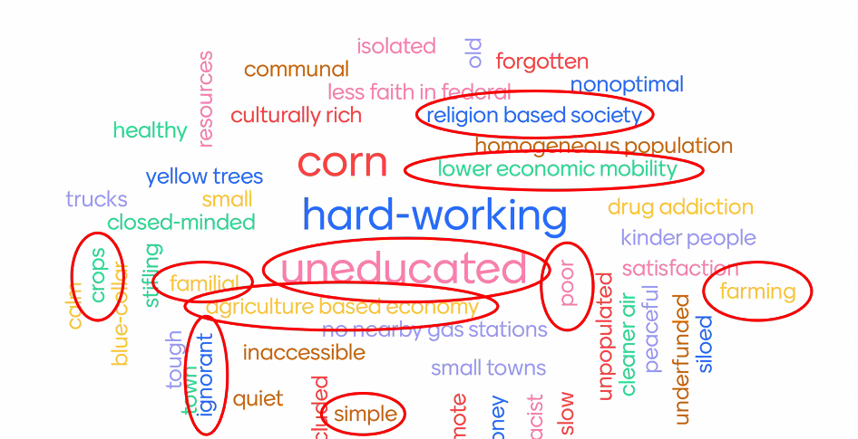
Understanding Bias
Data Science for Public Good project
Asked students:
What is life like in rural America?
What is the best thing about living in a rural community?
What is the worst thing about living in rural America?
What is the most pressing problem facing rural communities today?
How can a data scientist help rural communities?
What is life like in rural America?
Source: Shawn Dorius, Associate Professor, Social Demography, Iowa State University, Data Science for Public Good, Understanding Rural Bias, Summer 2020
34
Notes:
I want to present 2 examples of integrating ethics creatively into our research and application.
The Gates Foundation funded us to conduct research about economic mobility in rural areas in 3 states, VA, IA, and Oregon.
One of the professors leading some of this research discussed bias upfront by asking his students:
What is life like in rural America?
What is the best thing about living in a rural community?
What is the worst thing about living in rural America?
What is the most pressing problem facing rural communities today?
How can a data scientist help rural communities?
Using Mentimeter, a tool that allows groups to collect information anonymously from its members, the students were quite honest in their opinions.
Seeing their answers, they immediately understood their own implicit biases.
Next Slide

Slide 25
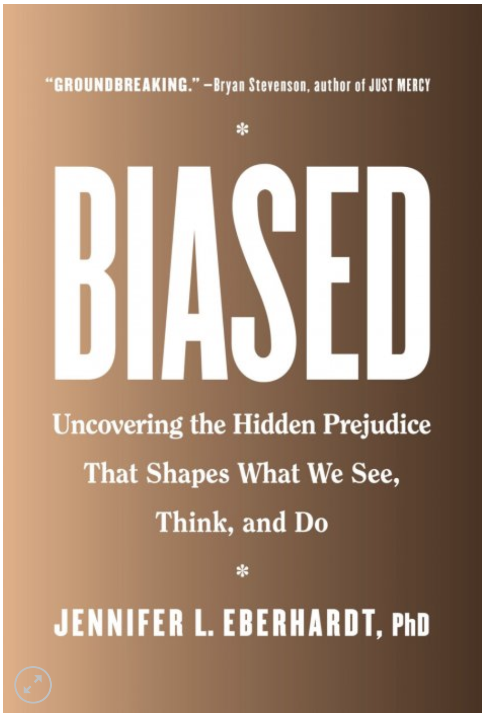
Practical Solutions – Introduce Friction
Social networking company Nextdoor saw that too many “suspicious character” postings on its online bulletin boards were based solely on race,
Eberhardt. Stanford psychologist, suggested they create a checklist so people had to specify suspicious behavior before describing appearance
Friction - people have to evaluate their reasoning before making bias-based assumptions
Incidence of racial profiling fell by 75%
Use of these data in research before change would perpetuate bias
35
Notes:
As background for a 2nd example, Jennifer Eberhardt is a Stanford psychologist and expert in working with police departments and others to understand and reduce implicit bias.
As one example, founders of the social networking company Nextdoor saw that too many “suspicious character” postings on its online bulletin boards were based solely on race.
They called Eberhardt in to consult. Based on her advice, they created a checklist so people logging on had to specify suspicious behavior before describing appearance.
That friction caused people to evaluate their reasoning before making bias-based assumptions.
The incidence of racial profiling fell by more than 75%.
I tell these stories for 2 reasons,
They took creativity.
What if we decided to use these data in a study about rural places or neighborhood safety or quality of life without acknowledging our biases when we makes choices about data or hypotheses or implicit biases in the data. Our results would perpetuate the biases.
Next Slide

Slide 26
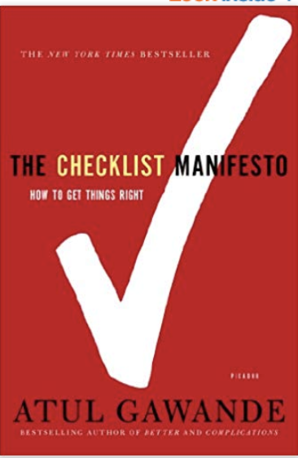
Incorporating Ethics into Data Science Lifecycle
Adapt criteria to ensure implementation of ethical principles
Make ethical considerations and discussion of implicit biases an active and continuous part of the project
Seek expert help when ethical questions at any stage cannot be answered
Incorporate ethical guidelines from relevant professional societies (e.g., American Statistical Association, American Physical Society)
Ensure documentation, transparency, ongoing discussion, questioning, and constructive criticism throughout the project
Notes:
Every research project should include a Data Science Ethics checklist at each phase of the project.
A key part of this checklist is the assessment of implicit biases throughout the project.
The ethical principles involved here require instilling ethics into all data science research practices that is reflected in project documentation, transparency, ongoing discussion, questioning, and constructive criticism.
A publicly-shared ethics checklist starts with the project planning phase that encompasses the entire project, not just completion of the Human Research Protections Program IRB process.
The IRB approval is necessary but not sufficient for addressing a researcher’s ethical responsibility in his/her research.
The checklist provides a mechanism to ensure that ethical principles be discussed throughout the project informally and formally at specific milestones.

Slide 27


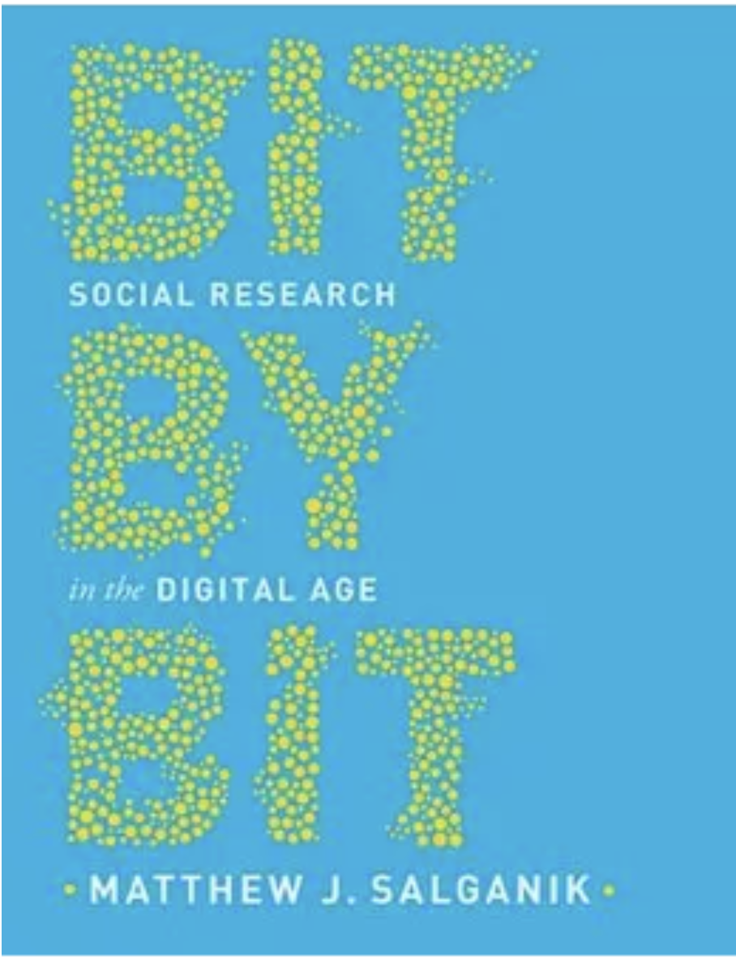
Selected Books on Ethics and Bias

